Slide 1

Week 1 – Getting Started Summer 2020
Wake Forest
School of Business
_______
Hands on Data Science

Slide 2
Study Groups
Blue
Gold
Week 1 – Getting Started.
Dataset 1 – Marketing Response
Setup Python Environment
Anaconda & Jupyter
Pandas Tutorial
Pandas Descriptive Statistics
Pandas Frequency Analysis
Pandas Charting
Exploration
Business Rules
Evaluation Metrics
Matplotlib Charts

Slide 3

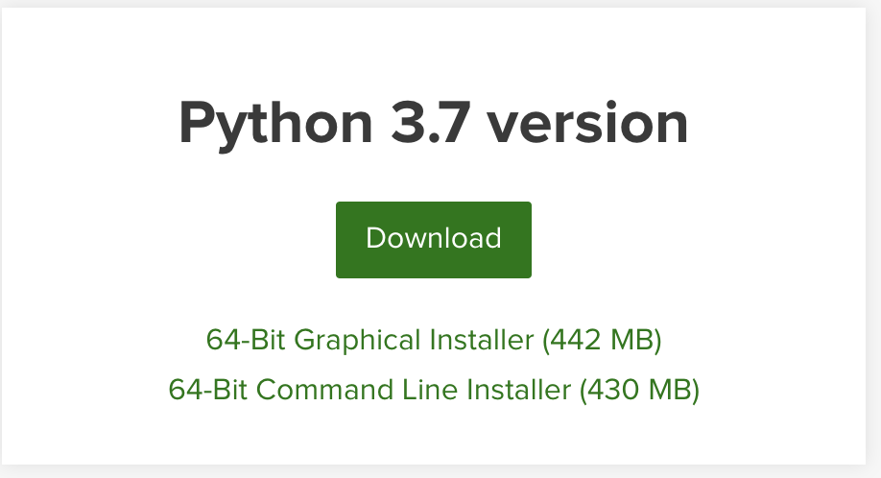
Setting up Python
https://www.anaconda.com/distribution/
Download and Install it. Use python 3.7!

Slide 4

Anaconda Navigator

Slide 5
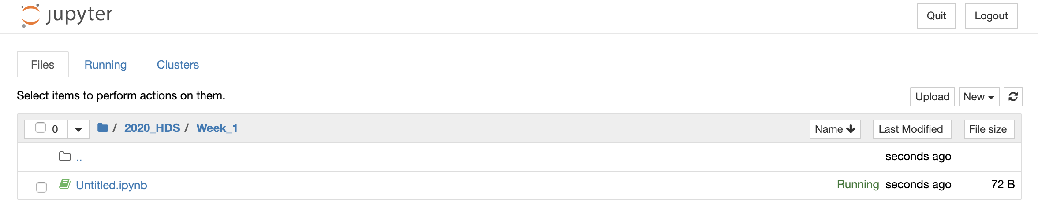
Jupyter Notebooks
Just points to a directory on your computer.
Step 1. make a folder for the class
Step 2. make a folder for the week
Step 3. create a notebook
New Notebook -> Python3

Slide 6
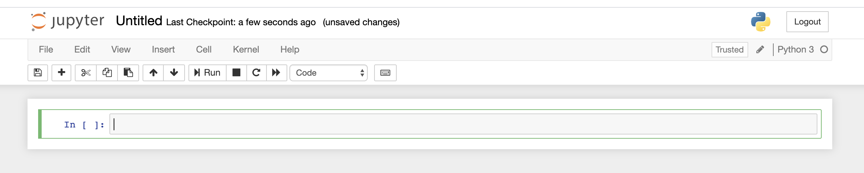
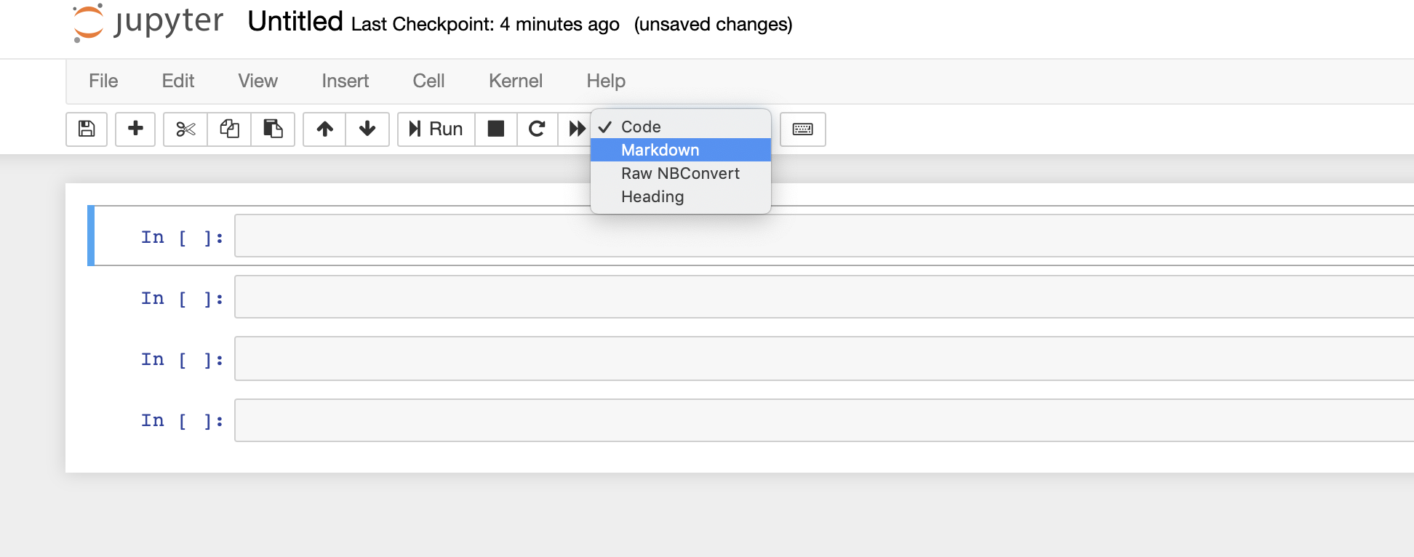
Your first Notebook
Notebook name, click and change it.
There are two types of cells we’ll be using
- Code
- Markdown

Slide 7
Quick and Dirty Python
Libraries & Packages
Simply a collection of functions and methods typically for a purpose.
Popular packages
Matplotlib
Numpy
Pandas
Sklearn
Datetime
Random
Install packages via command line
>pip install pandas
>conda install pandas

Slide 8
Pandas
DataFrame also known as a Table
Simply a Table with an index, rows and columns
df.loc[row_indexer, column_indexer]
Index | Column1 | Column2 | … | ColumnN
0
1
…
N
Row
Column

Slide 9
Pandas
Datatypes
Pandas supports the following data types
Numeric
Float
Integer
Character
Datetime
List
Dictionary

Slide 10
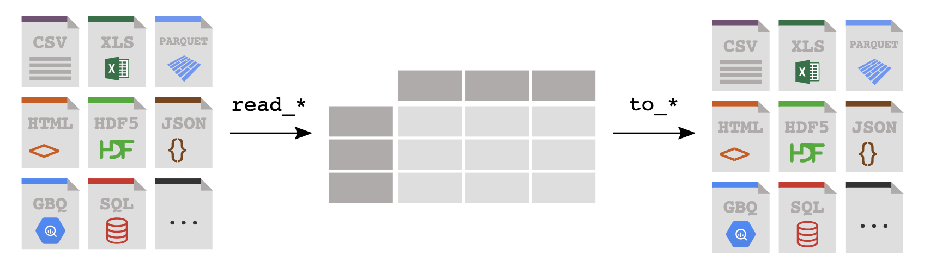
Pandas
Reading & Writing Data
Reading
df = pd.read_csv(‘myfile.csv’)
Rwrting
df.to_excel(‘myfile.xlsx’)
You read data from a file or database into a Pandas DataFrame, and you write from a DataFrame to a file or a database, the key is get data into Pandas!

Slide 11
Pandas
Series?
Think of it as a single column DataFrame
newSeries = df[“Column1”]
Series
Index | Column1 | Column2 | ColumnN
0
1
…
N
Index | Column1
0
1
…
N
=
> type(df[”Column1"])
% pandas.core.series.Series
https://pandas.pydata.org/pandas-docs/stable/reference/api/pandas.Series.html

Slide 12
Pandas
How do I “select specific columns”
Select specific ”columns” = [[ ]] – “bracket bracket”
newDataFrame = df[[ ”Column1”, “Column3”]]
DataFrame
Index | Column1 | Column2 | ColumnN
0
1
…
N
Index | Column1 | Column3
0
1
…
N
=
> type(df[”Column1"])
% pandas.core.frame.DataFrame
https://pandas.pydata.org/pandas-docs/stable/reference/api/pandas.DataFframe.html

Slide 13
Pandas
How do I “select specific rows?”
Select specific ”rows” =
queryResult = df[df[“Column1] == “value”]
DataFrame
Index | Column1 | Column2 | ColumnN
0
1
…
N
Index | Column1 | Column3
0
1
…
M
=
In [6]: type(df[”Column1"])
Out[6]: pandas.core.series.Series
https://pandas.pydata.org/pandas-docs/stable/reference/api/pandas.Series.html

Slide 14
Pandas
Conditional Operators
Pandas supports the common operator stuff
equal to: df[df[”column”] == “some_value”]
not equal to: df[df[”column”] != “some_value”]
greater than: df[df[”column”] > some_number ] (>,>=, <, M=)
In a list df[df[”column”].isin(a_list)]
use the squiggly “~” for not in a list, df[~df[”column”].isin(a_list)]
Multi-Conditions (&|)
AND: df[ (df[“column1” != “value”) & (df[“column2”] > some_nbr)]
OR : df[ (df[“column1” != “value”) | (df[“column2”] > some_nbr)]

Slide 15
Pandas
Useful functions
df.columns – returns a list of the names of the data frame’s columns
df.dtypes – provides the data types of your columns
df.info() – concise summary of dataframe
df.describe() – provides summary statistics of your DataFrame’s numeric columns
<class 'pandas.core.frame.DataFrame'>
RangeIndex: 3333 entries, 0 to 3332
Data columns (total 21 columns):
state 3333 non-null object
account_length 3333 non-null int64
area_code 3333 non-null int64
phone 3333 non-null object
 | count | mean | std | min | 0.25 | 0.5 | 0.75 | max
account_length | 3333 | 101.064806 | 39.822106 | 1 | 74 | 101 | 127 | 243
area_code | 3333 | 437.182418 | 42.37129 | 408 | 408 | 415 | 510 | 510
vmail_message | 3333 | 8.09901 | 13.688365 | 0 | 0 | 0 | 20 | 51

Slide 16
Pandas
df.query() a better way to filter rows …
Fast & readable queries for filtering rows.
Reference columns without quotes
Supports operators BUT concatenate conditions with “and”
df.query('area_code == "415" and \
intl_plan == "yes" and \
day_mins < 100 and \
state == ["WI", "OR", "WY"]')
state | area_code | phone | intl_plan | day_calls | state | day_mins | day_charge | eve_calls | eve_charge
WI | 415 | 355-7705 | yes | 92 | WI | 62.3 | 10.59 | 82 | 23.38
OR | 415 | 378-6772 | yes | 67 | OR | 12.5 | 2.13 | 90 | 21.81
WY | 415 | 412-3726 | yes | 117 | WY | 95.9 | 16.3 | 131 | 13.56

Slide 17
Pandas
df.query() reference
@ character identifies a variable to be evaluated rather than a column name, and lets you efficiently evaluate expressions.
mean_calls = df['day_calls'].mean()
state_list = ["WI", "OR", "WY"]
df.query('area_code == "415" and \
intl_plan == "yes" and \
day_calls < @mean_calls and \
state == @state_list')
state | area_code | phone | intl_plan | day_calls | state | day_mins | day_charge | eve_calls | eve_charge
OR | 415 | 332-9460 | yes | 87 | OR | 176.2 | 29.95 | 81 | 12.33
WI | 415 | 421-9401 | yes | 91 | WI | 264.3 | 44.93 | 115 | 13.68
WI | 415 | 355-7705 | yes | 92 | WI | 62.3 | 10.59 | 82 | 23.38
WY | 415 | 406-1349 | yes | 78 | WY | 189.6 | 32.23 | 117 | 22.73
WI | 415 | 339-6637 | yes | 97 | WI | 126.9 | 21.57 | 102 | 14.19

Slide 18
Pandas
df.sort_values() – ordering results

Slide 19
Pandas
df.rename(columns={})

Slide 20
Pandas
df.column.value_counts()

Slide 21
Pandas
pd.concatenate()

Slide 22
Pandas
Aggregations

Slide 24
Pandas
Method Chaining

Slide 25
Data Science
Framework / Design Pattern

Slide 26
First project
Stage
Import CSV into a pandas Dataframe
Clean up the column names!
Structure
Sort by
Reset index
Profile
Build a Table of Descriptive Statistics
Numeric Variables
Categorical Variables
Date Variables
Transform
Deal with missing values
Change churn from False. And True. To 0 and 1
Save transformed data
Re-Profile
Show that you’ve taken care of the problems.
Explore
Crosstab and bar chart of column plus churn
What’s column has the most likely impact on churn? And why?
Numeric
Histogram
Model w. Rule
Simple set of rules
Evaluate Performance
Confusion Matrix

Slide 28
T-Test Primer / Review
The problem
Does caffeine impact SAT test scores?
You want to know if rate of three point shots has changed from 2000s to the 2010s.
You want to know if there was insider trading on a particular stock. Ex. Martha Stewart and Imclone.
You want to know if training or a treatment has improved outcomes
These are all questions that you can use a t-test to answer

Slide 29
T-Test Primer / Review
Paired or Un-Paired
Hypothesis tests
H0 – no difference, any difference is simply by chance
H1 – difference, likely to be investigated
T-Test computes a p-value (no surprise)
If p-value is < 0.05 then the means are likely different
If p-value is >0.05 then the means are likely not different
Paired / Un-Paired
Paired – randomly select a group of people and give them the SAT twice, once with caffeine and once without caffeine
Same group, different treatments
Un-Paired – randomly select two groups of people give one coffee and the SAT and the other without coffee and the SAT
Different groups, different treatments

Slide 30
Recipe for T-TEST
Unpaired / paired – T-Tests
t.test(x,y, paired = FALSE)
Yeah that’s it. By default unpaired and unrelated
t.test(x,y, paired = TRUE)
Records in X match records Y
# A basic box with the conditions colored
ggplot(data, aes(x=cond, y=measure ,fill=cond)) +
geom_boxplot()
Paired t-test data:
p1$`MG Treated` and p2$`MG Treated`
t = 0.96891, df = 11, p-value = 0.3534
alternative hypothesis: true difference in means is not equal to 0 95 percent confidence interval: -137.6763 354.2129 sample estimates: mean of the differences 108.2683
Notes:
A paired t-test is used to compare two population means where you have two samples in which observations in one sample can be paired with observations in the other sample. Examples of where this might occur are: • Before-and-after observations on the same subjects (e.g. students’ diagnostic test results before and after a particular module or course).

Slide 31

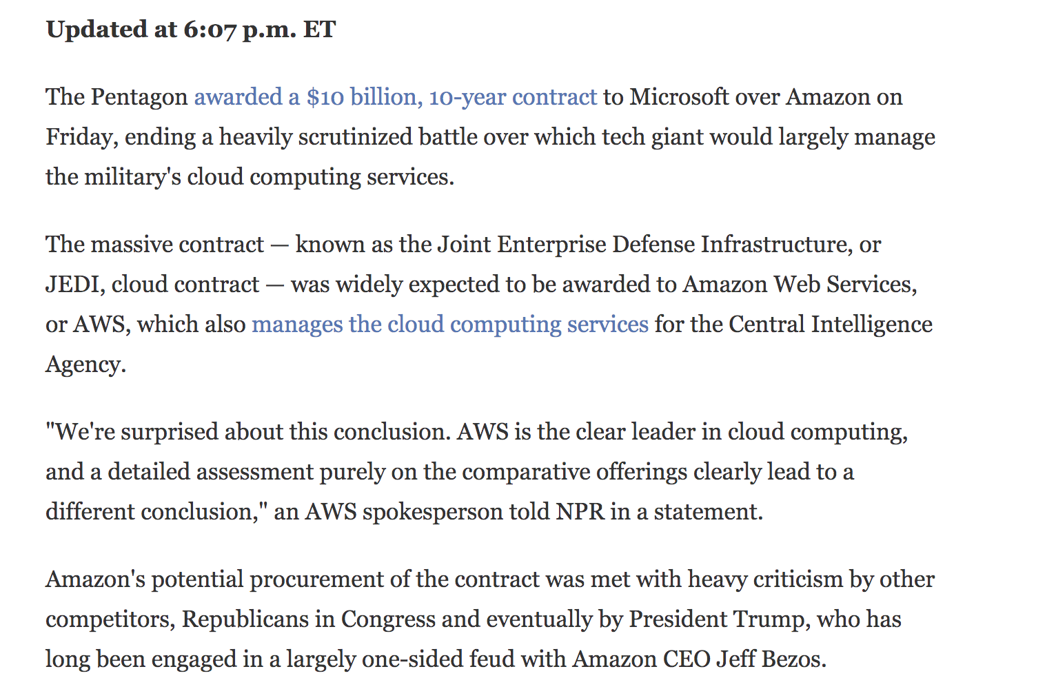
Real World Event Study Example
Suppose there is a major announcement, does it move the market?

Slide 32
There are a couple ways to do this…
Well we can use a T-Test to compare before and after performance of the two stocks

Slide 33
T-Test Example

Slide 34
Regression Primer / Review
Y = Xb + e
The term regression has appeared in early writings since the late 1300s, and is derived from the Latin term regressus, which means a return.
Regression analysis is a statistical process for studying the relationship between a set of independent variables (explanatory variables) and the dependent variable (response variable).
A regression analysis can have two objectives:
Explanatory analysis: To understand and weigh the effects of the independent variable on the dependent variable according to a particular theoretical model
Predictive analysis: To locate a linear combination of the independent variable to predict the value assumed by the dependent variable optimally

Slide 35
Regression Primer / Review
What is regression ?
Regression analysis is used to model the relationship between a dependent variable and one or more independent variables.
Things to be aware of…
Outliers - observations in the data having a very high or very low value as compared to the other observations in the data, i.e. it does not belong to the population, i.e. extreme values.
Multicollinearity - When the independent variables are correlated to each other then the variables are said to be “multicollinear”. Typically regression techniques assume multicollinearity is not present in the data.
Heteroscedasticity - When dependent variable's variability is not equal across values of an independent variable, it is called heteroscedasticity. Example - As one's income increases, the variability of food consumption will increase.
Underreg_modelting and Overreg_modelting - When we use unnecessary explanatory variables it might lead to overreg_modelting. Overreg_modelting means that our algorithm works well on the training set but is unable to perform better on the test sets. It is also known as problem of high variance.
Notes:
Suppose you are asked you to predict annual sales. There can be a hundred of factors, variables, drivers, attributes etc. that affects sales. In this case, sales is your dependent variable. Factors affecting sales are independent variables

Slide 36
Regression Primer / Review
Assumptions of Linear Regression
Linear Relationship between independent and dependent variables
A change in the independent variable produces a corresponding change in the dependent variable
Outliers are removed
Handle outliers by excluding or transforming (clipping, binning).
No Heteroscedasticity
Handle by using box-cox transformations
Sample observations should be independent.
one observation provides no information about the occurrence of another other observation.
Error terms should be normally distributed with mean 0 and constant variance.
Absence of multicollinearity and auto-correlation.
Remove highly correlated predictors from the model
Use principal components – save for another class..

Slide 37
There’s a package for that…
Rstats package
The rstats package is the core analytic package we’ll use
It contains several HUNDRED functions like:
“cor” for correlation analysis
“chisq.test” for comparing counts
“t.test” for comparing groups
“kmean” for clustering with kmeans
“glm” is used to reg_model generalized linear models
“lm” for reg_modelting linear models
“xtabs” to create contingency tables
The challenge is that there are probably a couple dozen other packages that offer a linear regression, when dealing with oddball packages check out:
Who wrote it
How popular is it
When was it last updated

Slide 38

What makes this stuff so hard?
“Language” of statistics, analytics and ml
IT / Business people we think of DATA in-terms of ROWS and COLUMNS – SQL
Statistics & Machine Learning: vectors and matrices, observations and features…
Black box, Mystique of Statistics…
Relying on intuition and experience “I feel, I think, I believe, In my Experience, it should”
A “model” is nothing more than relationships between variables…
Resulting in a formula or instruction set that generalizes the relationship …
Height = w1*Age + w2*Weight + w3*Gender + intercept

Slide 39
What makes this so hard…
What I wish every IT person knew
PriceReg <- lm($TotalSalePrice$ ~ Age + HEATEDSQFT + DEED_ACRES + CITY)
Your Database returns … a result set…
Your Stats guy is going to transform things…
TOTSALPRICE | YEAR_BUILT | HEATEDSQFT | DEED_ACRES | CITY
234000 | 1998 | 2320 | 0.18 | RALEIGH
136000 | 2005 | 1744 | 0.16 | RALEIGH
140000 | 1969 | 1962 | 0.04 | RALEIGH
311500 | 1998 | 2440 | 0.25 | APEX
50000 | 1945 | 1134 | 0.1 | RALEIGH
526500 | 1969 | 5303 | 0.85 | RALEIGH
139500 | 1998 | 1486 | 0.15 | HOLLY SPRINGS
205000 | 2002 | 2243 | 0.17 | MORRISVILLE
307000 | 2005 | 3280 | 0.18 | MORRISVILLE
147000 | 1997 | 1762 | 0.15 | HOLLY SPRINGS
265000 | 1965 | 4963 | 0.46 | RALEIGH
196000 | 2002 | 2074 | 0.17 | MORRISVILLE
71000 | 1961 | 1520 | 0.33 | RALEIGH
112000 | 1979 | 1285 | 0.56 | ZEBULON
302000 | 2002 | 3312 | 0.25 | APEX
218500 | 1995 | 2568 | 0.26 | CARY
152500 | 2002 | 1677 | 0.15 | GARNER
TOTSALPRICE | AGE | HEATEDSQFT | DEED_ACRES | RALEIGH | APEX | HOLLY SPRINGS | MORRISVILLE | ZEBULON
234000 | 17 | 2320 | 0.18 | 1 | 0 | 0 | 0 | 0
136000 | 10 | 1744 | 0.16 | 1 | 0 | 0 | 0 | 0
140000 | 46 | 1962 | 0.04 | 1 | 0 | 0 | 0 | 0
311500 | 17 | 2440 | 0.25 | 0 | 1 | 0 | 0 | 0
50000 | 70 | 1134 | 0.1 | 1 | 0 | 0 | 0 | 0
526500 | 46 | 5303 | 0.85 | 1 | 0 | 0 | 0 | 0
139500 | 17 | 1486 | 0.15 | 0 | 0 | 1 | 0 | 0
205000 | 13 | 2243 | 0.17 | 0 | 0 | 0 | 1 | 0
307000 | 10 | 3280 | 0.18 | 0 | 0 | 0 | 1 | 0
147000 | 18 | 1762 | 0.15 | 0 | 0 | 1 | 0 | 0
265000 | 50 | 4963 | 0.46 | 1 | 0 | 0 | 0 | 0
196000 | 13 | 2074 | 0.17 | 0 | 0 | 0 | 1 | 0
71000 | 54 | 1520 | 0.33 | 1 | 0 | 0 | 0 | 0
112000 | 36 | 1285 | 0.56 | 0 | 0 | 0 | 0 | 1
302000 | 13 | 3312 | 0.25 | 0 | 1 | 0 | 0 | 0
218500 | 20 | 2568 | 0.26 | 0 | 1 | 0 | 0 | 0
152500 | 13 | 1677 | 0.15 | 0 | 1 | 0 | 0 | 0
Most methods only deal with continuous numeric values
Factors - are an “R-ism” to represent 0/1s for categories within the data avoiding:
One hot Encoding or Discretization , or making 1s and 0s, for example city transformed into 0/1
Transformations – are need to satisfy model assumptions (normality), express predictive power, or simply to create useful variables for example year could be a factor or we could transform it to AGE
Calculate: Age = 2015 - Year Built

Slide 40
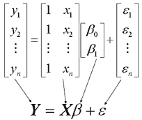
Pull back the curtain
Academics deal in matrices and vectors
A matrix is a collection of numeric data arranged in a two-dimensional rectangular layout i.e. rows and columns
A vector is a sequence of numeric data think of it as a 1-dimensional array
Matrix Algebra, aka matrix math or linear algebra is the language of statistics and algorithms
X is an n × 2 matrix.
Y is an n × 1 column vector,
β is a 2 × 1 column vector,
ε is an n × 1 column vector.
The matrix X and vector β are multiplied together using the techniques of matrix multiplication.
And, the vector Xβ is added to the vector ε using the techniques of matrix addition.

Slide 41
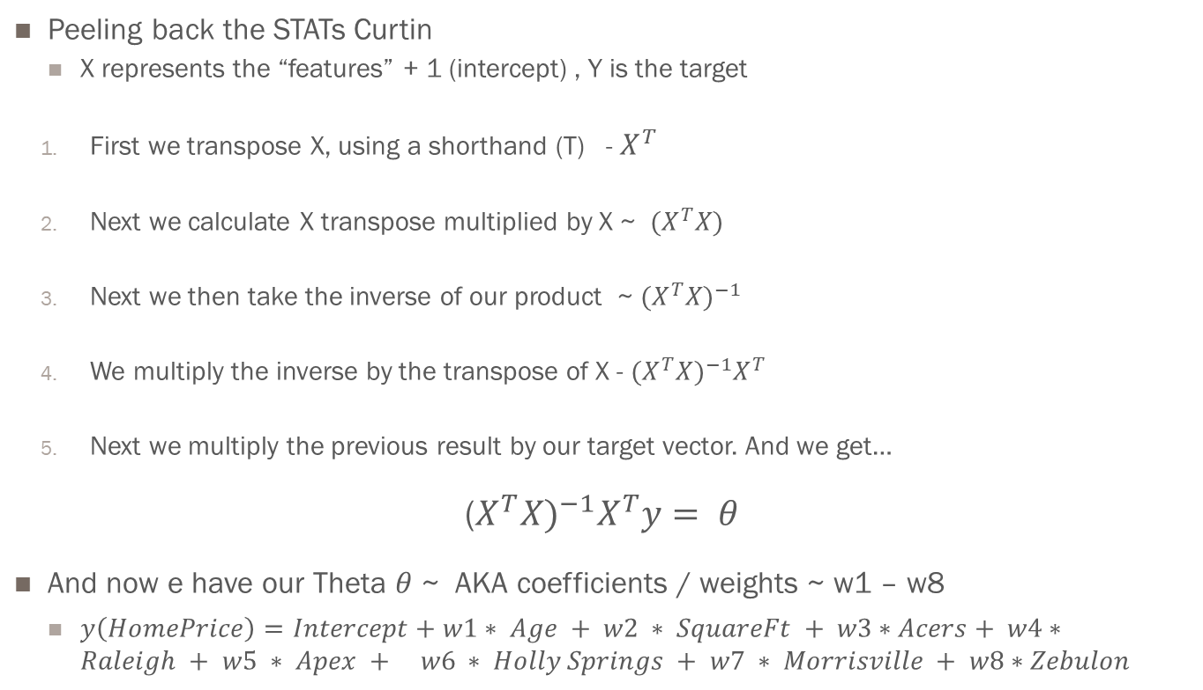
Matrix Math
Ok how to solve the normal equation
Peeling back the STATs Curtin
X represents the “features” + 1 (intercept) , Y is the target
First we transpose X, using a shorthand (T) - $X^{T}$
Next we calculate X transpose multiplied by X ~ ${(X}^{T}X)$
Next we then take the inverse of our product ~ $(X^{T}X)^{−1}$
We multiply the inverse by the transpose of X - $(X^{T}X)^{−1}X^{T}$
Next we multiply the previous result by our target vector. And we get…
($X^{T}{X)}^{−1}X^{T}y= θ$
And now e have our Theta $θ$ ~ AKA coefficients / weights ~ w1 – w8
$y\left(HomePrice\right)=Intercept+w1∗ Age + w2 ∗ SquareFt + w3∗Acers+ w4∗Raleigh + w5 ∗ Apex + w6 ∗ Holly Springs + w7 ∗ Morrisville + w8∗Zebulon$

Slide 42
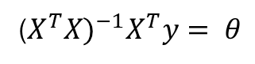
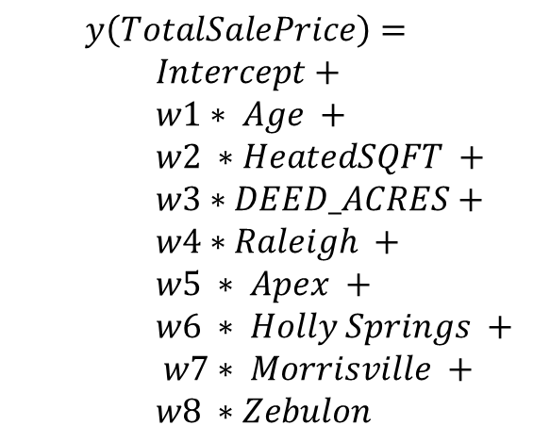
It’s the language that is hard
Let the computer do the work for you…
TOTSALPRICE | AGE | HEATEDSQFT | DEED_ACRES | RALEIGH | APEX | HOLLY SPRINGS | MORRISVILLE | ZEBULON
234000 | 17 | 2320 | 0.18 | 1 | 0 | 0 | 0 | 0
136000 | 10 | 1744 | 0.16 | 1 | 0 | 0 | 0 | 0
140000 | 46 | 1962 | 0.04 | 1 | 0 | 0 | 0 | 0
311500 | 17 | 2440 | 0.25 | 0 | 1 | 0 | 0 | 0
50000 | 70 | 1134 | 0.1 | 1 | 0 | 0 | 0 | 0
526500 | 46 | 5303 | 0.85 | 1 | 0 | 0 | 0 | 0
139500 | 17 | 1486 | 0.15 | 0 | 0 | 1 | 0 | 0
205000 | 13 | 2243 | 0.17 | 0 | 0 | 0 | 1 | 0
307000 | 10 | 3280 | 0.18 | 0 | 0 | 0 | 1 | 0
147000 | 18 | 1762 | 0.15 | 0 | 0 | 1 | 0 | 0
265000 | 50 | 4963 | 0.46 | 1 | 0 | 0 | 0 | 0
196000 | 13 | 2074 | 0.17 | 0 | 0 | 0 | 1 | 0
71000 | 54 | 1520 | 0.33 | 1 | 0 | 0 | 0 | 0
112000 | 36 | 1285 | 0.56 | 0 | 0 | 0 | 0 | 1
302000 | 13 | 3312 | 0.25 | 0 | 1 | 0 | 0 | 0
218500 | 20 | 2568 | 0.26 | 0 | 1 | 0 | 0 | 0
152500 | 13 | 1677 | 0.15 | 0 | 1 | 0 | 0 | 0
$$y\left(TotalSalePrice\right)=$$
$$Intercept+$$
$$w1∗ Age +$$
$$w2 ∗HeatedSQFT +$$
$$w3∗DEED_ACRES+$$
$$w4∗Raleigh +$$
$$w5 ∗ Apex +$$
$$w6 ∗ Holly Springs +$$
$$w7∗ Morrisville +$$
$$w8 ∗Zebulon$$
($X^{T}{X)}^{−1}X^{T}y= θ$
PriceReg <- lm($TotalSalePrice$ ~ Age + HEATEDSQFT + DEED_ACRES + CITY)

Slide 43
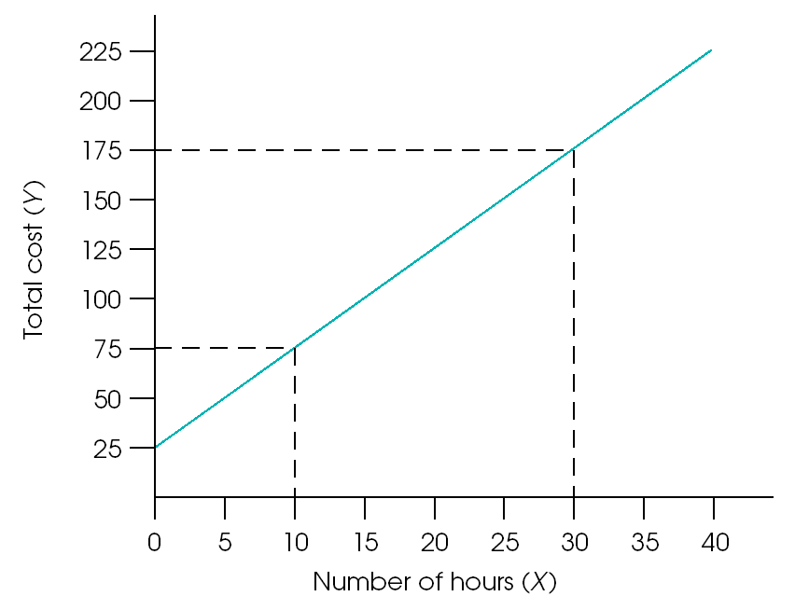
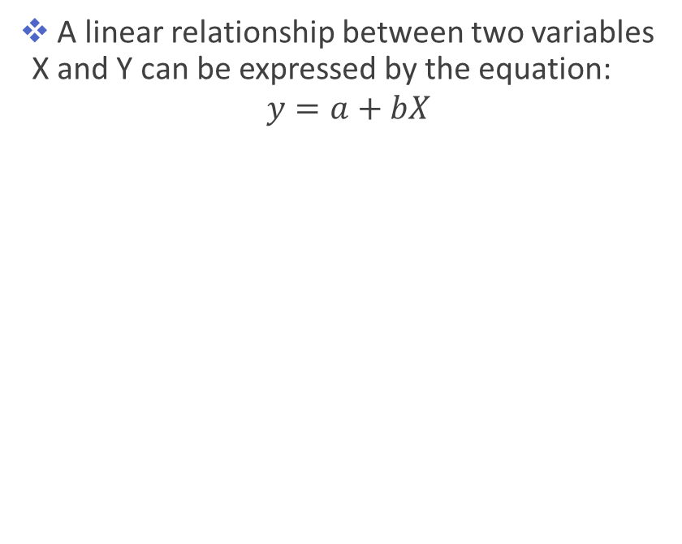
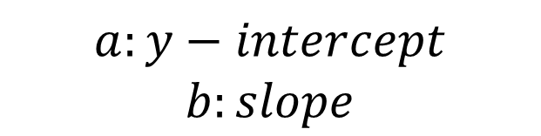
Linear Relationship
Y = a + bX
A linear relationship between two variables X and Y can be expressed by the equation:
$$y=a+bX$$
$$a:y−intercept$$
$$b:slope$$
Relationship between total cost and number of hours playing tennis. The tennis club charges a $25 membership fee plus $5 per hour. The relationship is described by a linear equation:
Total Cost = $25 + $5 * (number of hours)

Slide 44
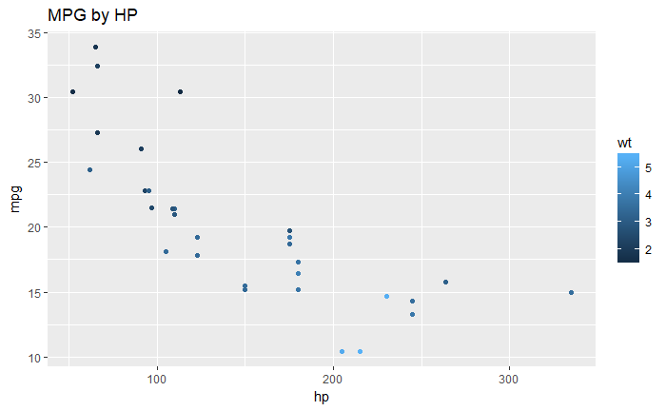
An Example with Cars
Y = a + bX
Question: Is there a relationship between HP and MPG?
mpg | hp
21 | 110
21 | 110
22.8 | 93
21.4 | 110
18.7 | 175
18.1 | 105
14.3 | 245
24.4 | 62
22.8 | 95
19.2 | 123

Slide 45
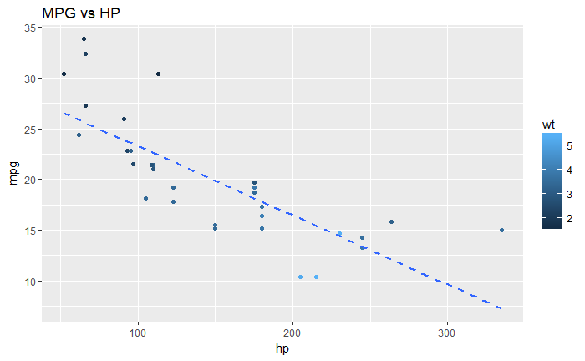
An Example with Cars
Y = a + bX
Question: Is there a relationship between HP and MPG?
mpg | hp
21 | 110
21 | 110
22.8 | 93
21.4 | 110
18.7 | 175
18.1 | 105
14.3 | 245
24.4 | 62
22.8 | 95
19.2 | 123

Slide 46
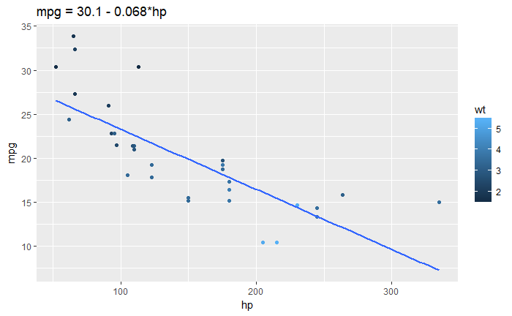
An Example with Cars
Y = a + bX
Correlation (r): quantify the strength of the relationship between two variables. The squared correlation(r^2) tells us about the proportion of the shared variation.
r = - 0.77
r^2 = 0.59

Slide 47
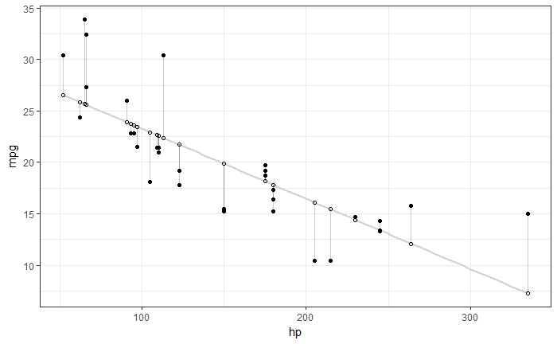
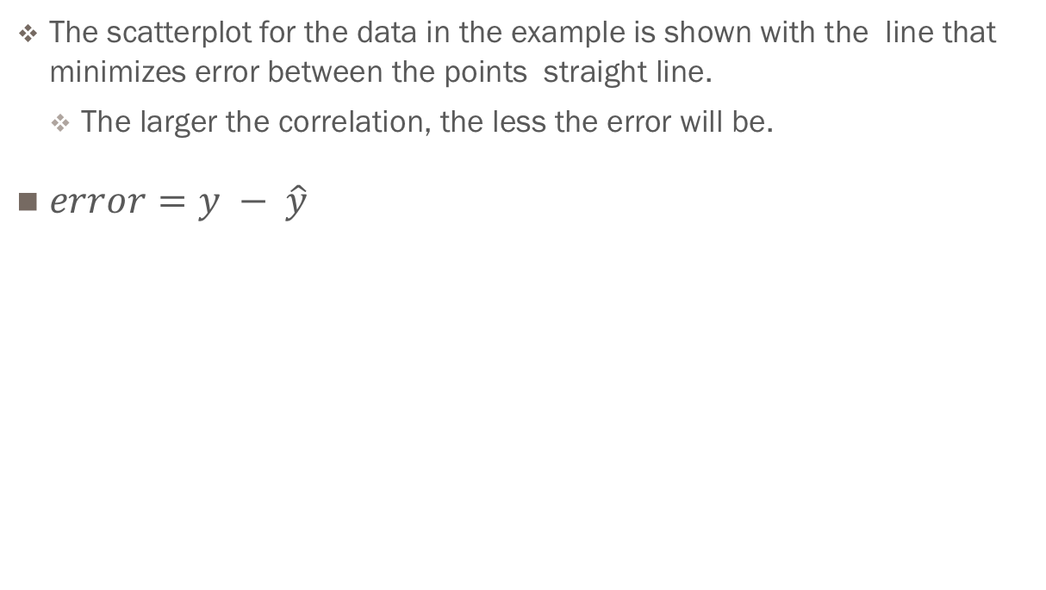
Error
The scatterplot for the data in the example is shown with the line that minimizes error between the points straight line.
The larger the correlation, the less the error will be.
$error=y − \hat{y}$

Slide 48
Recipe for Regression with R
Basic sugar cookie
Stage your Data
Get it into a R Data.frame or Tibble
Explore your data
Discard any columns that have lots of missing values
Discard observations that have lots of missing values
Prepare/Transform your data
Create useful new variables
Transform variables to achieve uniformity
Partition (split) your data into a Training and Test datasets (70/30)
Train your regression with the Training dataset using the rstats package (lm)
Evaluate : R Square, Equation
Remove variables with high p-values (p > 0.1 ) and repeat REG
Evaluate the performance on the Test dataset
“score” the test data
Visually compare test residuals to training residuals with histograms
Compare Mean Squared Error (MSE) of training residuals and test residuals should be similar

Slide 49
Recipe for Regression
sugar cookie – EXPLORE
Use dplyr (summarize_all) and tidyr (gather)
Perform frequency counts for factors / categorical variables
N_distinct, n_missing,
Create summary statistics for continuous / numeric variables
Min, max, mean, median, n, n_distinct
Use cor function to create a correlation matrix
Visualize variables with GGPLOT2 scatter(geom_point), box(geom_box), and histograms (geom_histogram)
Visualize different variable transformations for skew’d distributions (scatter and histogram)
LOG(x), LN(x), X^2, 1/X, SQRT(X)
Which one looks more “normal”
Identify outliers and extremes
Describe rules to exclude those
Use dplyr summarize and group by & ggplot2 to explore categorical / nominal variables
Should always produce:
Frequency summary statistics of all variables (n, nmiss, distinct)
Frequency analysis (n, nmiss, distinct, mode, PCT missing)
Identify DQ issues and Handle Missing values
Visualize top N frequencies with ggplot & histograms (vertical)

Slide 50
Recipe for Regression
sugar cookie – Prepare/Transform
Transform continuous variables
Replace missing with Median or Mean with “mutate”
Apply “normalization” formulas
LOG(x), LN(x), X^2, 1/X, SQRT(X)
Deal with DQ(Data Quality) issues for nominal / categorical variables
Garbage in/out
Remove junk
CASE When or IF X IN () /THEN X ~ …

Slide 51
Recipe for Regression
sugar cookie – Partition 70/30
Option 1 – “vector selector” way using sample.int
sample <- sample.int(n = nrow(df), size = floor(0.7*nrow(df)), replace = F)
train <- df[sample, ]
test <- df[-sample, ]
Option 2 – “resample example”, way tidyverse wants you to do it.
ex <- resample_partition(df, c(test = 0.3, train = 0.7))
mod <- lm(y ~x , data = ex$train)
resample stores a “reference” to the original dataset and a vector of row indices just like option 1, its supposed to be easier…

Slide 52
Recipe for Regression
Sugar cookie – in R
reg_model <-
lm( y ~
var1 +
var2 + …
varN,
data = <input dataset > )
Specify the regression formula
What about all the diagnostics !
summary(reg_model) # model summary
coefficients(reg_model) # model coefficients
confint(reg_model, level=0.95) # CIs for model parameters
reg_modelted(reg_model) # predicted values
residuals(reg_model) # residuals
anova(reg_model) # anova table
vcov(reg_model) # covariance matrix for model parameters
influence(reg_model) # regression diagnostics

Slide 53
Recipe for Regression
What about all those diagnostics !
reg_model <-
lm( y ~ var1 + var2 + … varN, data = <input dataset > )
Default functions
plot(reg_model) - prints diagnostic plots
summary(reg_model) – prints the model diagnostics (rsqare, coef, etc.)
Modelr functions
rmse(reg_model), rsquare(reg_model), mae(reg_model), que(reg_model)
add_predictions(reg_model), add_residuals(reg_model)
Broom functions
tidy(reg_model) – make a dataframe that summarizes your model
augment(reg_model) add predictions, residuals, and clusters to training data
Glance(reg_model) - a concise one-row summary of the model.

Slide 54
Recipe for Regression
What about variable selection?
Create a “null model”, “full model” and step
null=lm( Y ~1, data=mydata)
full=lm( Y ~ all_vars_vector, data=mydata)
step(null, scope=list(lower=null,
upper=full),
direction="both/forward/backward")
Different variable selection methods. Read about them.
When you need to go beyond the basics this is where you have to be cautious about the packages you select.

Slide 55
Recipe for Regression
)
Stepwise selection options
Use the olsrr package
ols_regress ( Y ~ X1 + X2 … data=<input dataset >)
ols_step_both_p(model, pent, prem) # p-values to enter and remain
ols_step_forward_p(model, pent) # p-value to enter
ols_step_backward_p(model, prem ) # p-value to remain
ols_step_best_subset(model) # slow
ols_step_all_possible(model) # slow
https://www.rdocumentation.org/packages/olsrr/versions/0.5.1
Note: it can be a pain to install sometimes…

Slide 56
Recipe for Regression
sugar cookie – Evaluating a Regression Model
Summary
Summary(model)
Model Coefficients
Coef(model)
Confint(model) – coefficient confidence intervals
Model Residuals
Resid(model)
Residual Sum of Squares
Deviance(model)
Anova
Anova(model)

Slide 57
Recipe for Regression
sugar cookie – Evaluating a Regression Model
Multiple R-squared: 0.7421, Adjusted R-squared: 0.7418
F-statistic: 2725 on 14 and 13258 DF, p-value: < 2.2e-16
Analysis of Variance tests the overall predictive utility of the model.
The null hypothesis is: H0: R2=0, that there is no predictive utility for the model.
The alternative is H1: R2>0, that there is some predictive utility of the model.
Key thing to look at!
If p < 0.05, we reject the null.
Here, p < 0.0001 (the column labeled Pr>F)
So we reject the null hypothesis and determine that our model has some predictive utility
r.squared | adj.r.squared | sigma | statistic | p.value | df
0.74208678 | 0.74181444 | 75247.1573 | 2724.77772 | 0 | 15

Slide 58
Recipe for Regression
sugar cookie – Evaluating a Regression Model
r.squared | adj.r.squared | sigma | statistic | p.value | df
0.74208678 | 0.74181444 | 75247.1573 | 2724.77772 | 0 | 15
R-square =R² = % of variance in the DV (dependent variable) that is explained by the combination of Ivs (independent variables).
Here, 74.2% of the variance in AV_TOTAL is explained by the model
We often have reason to believe that our independent variables are correlated with one another, and we might be inflating our R² because of this. So we use the adjusted R². The adjusted R² is a modified version of R² that has been “adjusted” for the number of predictors in the model. The adjusted R² increases only if the new term improves the model more than would be expected by chance.
Here, 74.18% of the variance AV_TOTAL is explained by the model, after It’s adjusted for the number of predictors in the model (14)
Notes:
Suppose you compare the 3-predictor model’s R² to a one-predictor model’s R². Does this model have a higher R² because it’s better? Or is the R² higher because it has two more predictors?

Slide 59
Recipe for Regression
sugar cookie – Evaluating a Regression Model
term | estimate | std.error | statistic | p.value
(Intercept) | 199629.201 | 75534.8129 | 2.64287675 | 0.01
OWN_OCCY | 20360.2123 | 2008.97123 | 10.134646 | 0.00
bld_age | -504.47743 | 44.3450652 | -11.37618 | 0.00
GROSS_AREA | 50.5615588 | 2.01205175 | 25.129353 | 0.00
LAND_SF | 8.70887868 | 0.25329505 | 34.3823484 | 0.00
LIVING_AREA | 43.9671641 | 3.64048281 | 12.0772893 | 0.00
NUM_FLOORS | 48684.7469 | 1989.16564 | 24.4749587 | 0.00
R_BDRMS | -5444.1379 | 1058.84833 | -5.1415654 | 0.00
R_FULL_BTH | 22400.456 | 1342.99568 | 16.6794699 | 0.00
R_TOTAL_RMS | 3694.77481 | 700.646502 | 5.27337937 | 0.00
YR_BUILT | -102.2723 | 37.3437357 | -2.7386734 | 0.01
zip_02124 | 1762.47145 | 2330.80096 | 0.75616557 | 0.45
zip_02130 | 271203.503 | 2626.85225 | 103.24277 | 0.00
zip_02131 | 82471.3794 | 2088.68718 | 39.4847923 | 0.00
zip_02132 | 108875.46 | 1758.33979 | 61.9194655 | 0.00
The Parameter Estimates table provides the intercept and slope(s), and their associated t-test(s). The t-tests are always testing the null hypothesis that the parameter is 0 (H0: b=0, that the variable associated with that parameter does not predict the DV) against the alternative that it is not 0 (i.e., that it does predict the DV).

Slide 60
Recipe for Regression
sugar cookie – Evaluating a Regression Model
term | estimate | p.value | stb
zip_02130 | 271203.5 | 0 | 0.52656712
zip_02132 | 108875.46 | 0 | 0.34808111
GROSS_AREA | 50.56 | 0 | 0.30602002
zip_02131 | 82471.38 | 0 | 0.21226428
LAND_SF | 8.71 | 0 | 0.17020988
LIVING_AREA | 43.97 | 0 | 0.16400788
NUM_FLOORS | 48684.75 | 0 | 0.14742637
R_FULL_BTH | 22400.46 | 0 | 0.08384587
OWN_OCCY | 20360.21 | 0 | 0.0448392
R_TOTAL_RMS | 3694.77 | 0 | 0.03913027
so to get the Standardized Estimates, you need a package lm.beta (of course there are dozen others that will do a similar stunt) Standardized estimates provides a measure of variable importance. You can use this to “rank” the independent variables by importance to the model. And of course it’s a pain to get these things together… here

Slide 61
Chunk O’code
tidy(m1) %>%
mutate_at(vars(c("estimate", "p.value")), funs(round(.,2)) ) %>%
select(term,
estimate,
p.value)
# standardize
library(lm.beta)
m1.beta <- lm.beta(m1)
bind_cols(tidy(m1) %>%
mutate_at(vars(c("estimate", "p.value")), funs(round(.,2)) ) %>%
select(term, estimate, p.value) ,
as_tibble(coef(m1.beta))) %>%
rename(stb=value) %>%
arrange(desc(stb))

Slide 62
Recipe for Regression
sugar cookie – Evaluating a Regression Model

Slide 63
Recipe for Regression
Sugar cookie – eval. train vs test. MAE MSE RMSE
rmse(mod, ex$train)
rmse(mod, ex$test)
[1] 114690.5
[1] 113212.4
RMSE – root mean squared error, should be pretty close to equal across partitions

